Slide 1
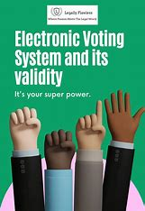
E - VOTING SYSTEM
Project By,
Vishnu Vardhan A (192211909)
Rajesh Reddy Y(192211902)
Supervisor,
Dr. Jayasakthi Velmurgan K

Slide 2

INTRODUCTION
Voting is a cornerstone of democratic processes, providing citizens with the means to influence government and organizational decisions. Traditional paper-based voting systems, while established, have numerous drawbacks including logistical challenges, high costs, and potential security vulnerabilities. In response to these challenges, electronic voting (e-voting) systems have emerged as a modern alternative.

Slide 3

PROJECT SCOPE
The aim of the E-Voting System is to modernize voting by providing a secure, efficient, and accessible platform. Using dual-factor authentication and encryption, it ensures only eligible voters participate and that each vote is private.
For administrators, the system simplifies election management through real-time
tallying and a user-friendly interface, reducing manual errors.

Slide 4

EXISTING SYSTEM
The existing voting system primarily relies on paper ballots and in-person voting, requiring extensive resources and manual vote counting. This traditional method is time-consuming, labor-intensive, and prone to human error, often causing delays and inaccuracies. While some places use electronic machines, they often lack standardized security protocols.

Slide 5

PROPOSED SYSTEM
The proposed e-voting system aims to enhance the electoral process by providing a secure, accessible, and efficient voting platform.
It will utilize encrypted digital ballots to ensure voter privacy and prevent tampering, making the voting process more transparent.
The system will include identity verification measures, such as biometric authentication, to ensure that only eligible voters can cast their ballots.

Slide 6
TECHNOLOGY
Frontend: The frontend is built using HTML for structuring each page, CSS for styling, and Bootstrap for a responsive layout. Bootstrap components, like the navigation bar and buttons, help create a visually appealing and user-friendly interface, enhancing accessibility across devices. jQuery is used to enable Bootstrap’s interactive components, such as dropdowns and navigation collapse, ensuring a smoother experience for users.
Backend: The backend consists of PHP for handling server-side processes, such as saving votes (Savevote.php) and managing authentication (authentication.php). PHP scripts process data submitted from the frontend, performing actions like validating user logins or recording votes in the database. MySQL (or a similar database like MariaDB) is used to store structured data securely, holding essential information like user accounts, voting records, and candidate details.

Slide 7
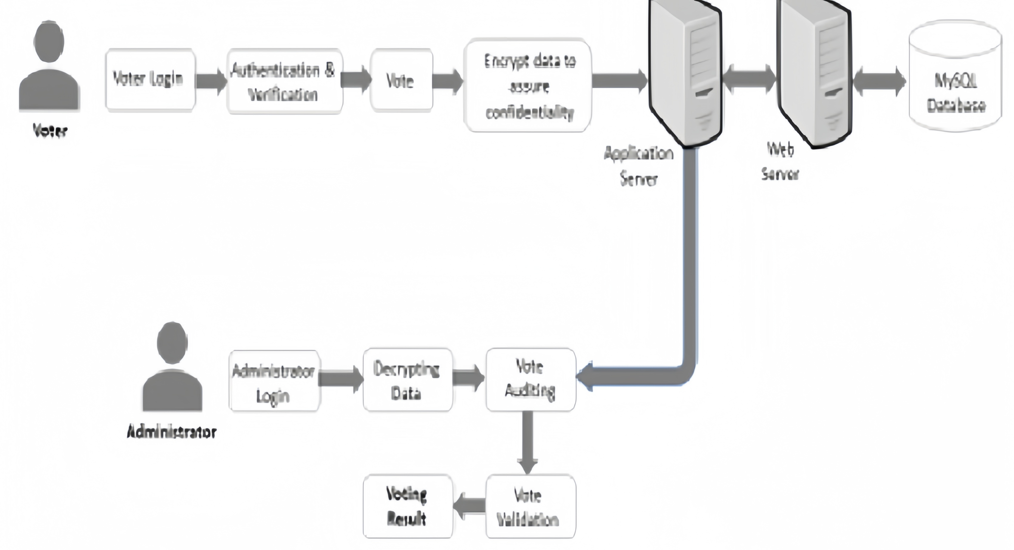
BLOCK DIAGRAM

Slide 8
MODULES
User Registration Module : Function: Handles the registration of new users, capturing personal details and verifying their identity
Authentication Module: Function: Verifies the identity of registered voters.
Voting Module: Function: Manages the voting process, from presenting the ballot to casting the vote.
Tallying Module Function: Counts votes and updates results in real-time.
Result Display Module Function: Presents the election results once voting is complete.
Security Module Function: Ensures the integrity and security of the voting process.

Slide 9
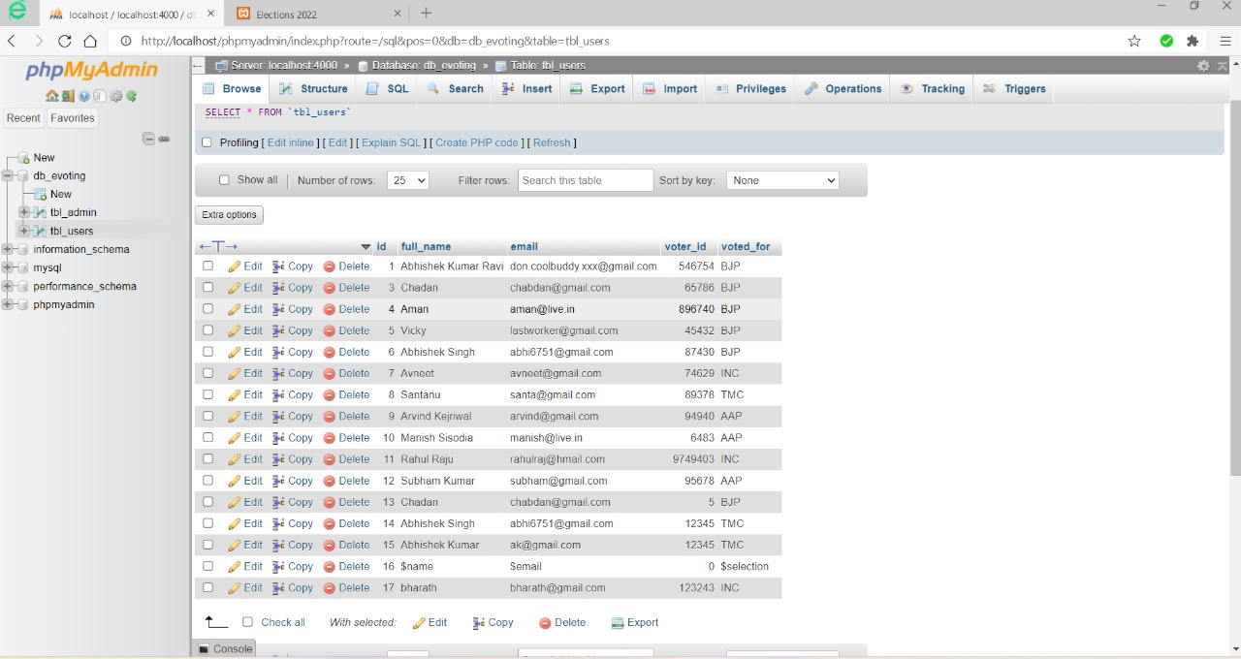

Slide 10
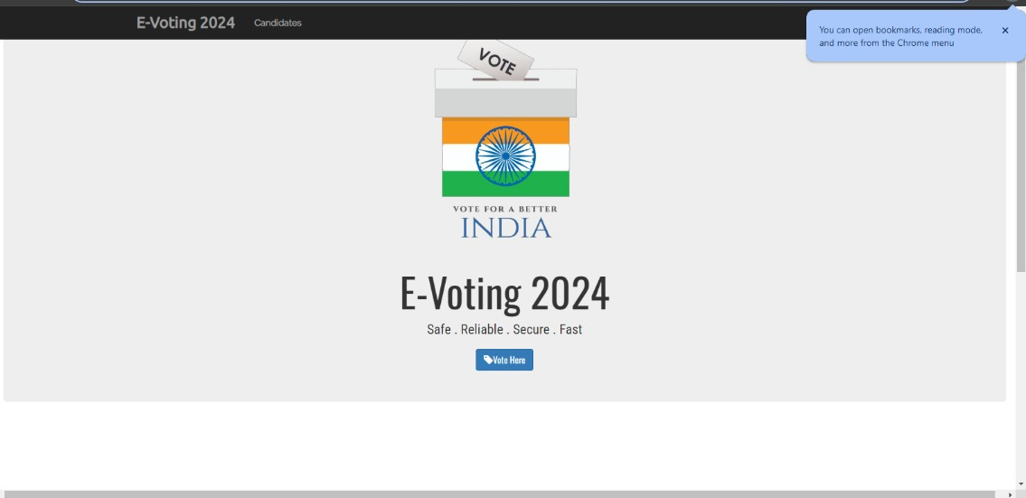
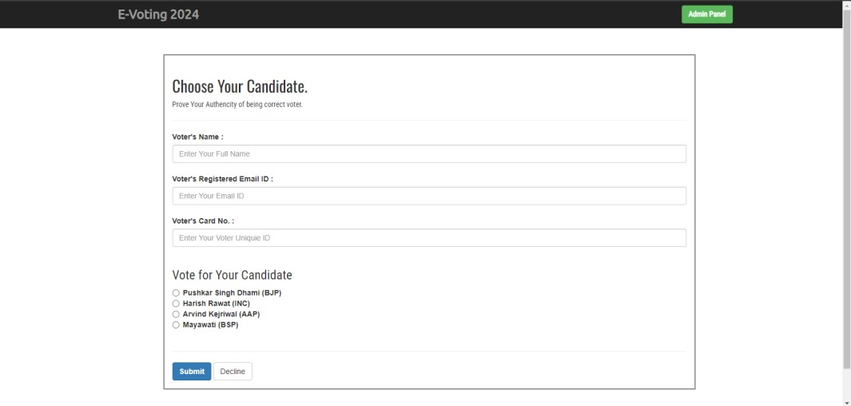
IMPLEMENTATION

Slide 11
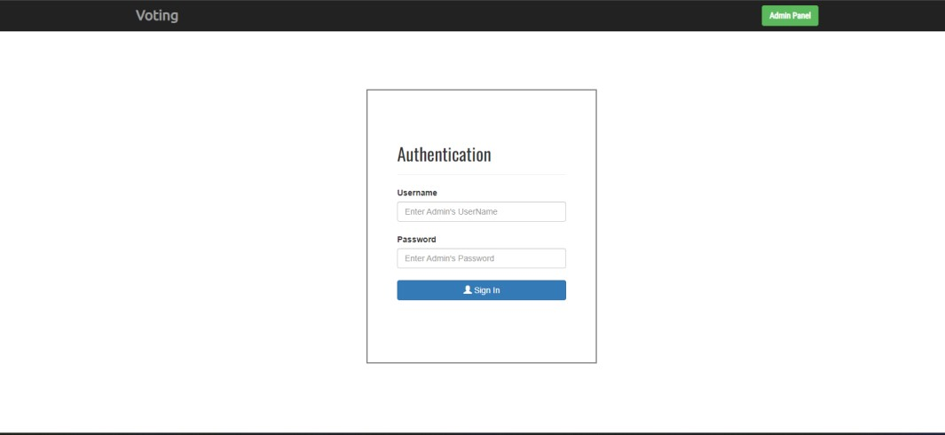
IMPLEMENTATION

Slide 12
FUTURE SCOPE
Integration with Government Databases: Integrating the e-voting system with government databases for real-time verification of voter eligibility.
Advanced Security Measures: Implementing more advanced security measures such as blockchain technology to further enhance vote integrity.
Mobile Application: Creating a mobile application to enable voters to cast their votes securely from their smartphones.
Detailed Analytics: Adding analytics features to provide insights into voter turnout and patterns, which can help improve future elections.

Slide 13
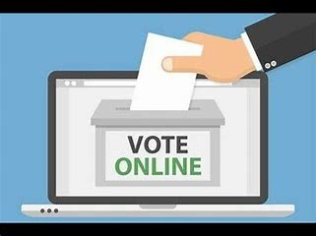
CONCLUSION
The e-voting system represents a significant advancement in the way elections are conducted. By leveraging modern technology, it addresses the limitations of traditional voting methods, offering a secure, efficient, and user-friendly alternative. This project not only enhances the voting experience but also contributes to the integrity and reliability of the electoral process, ultimately fostering greater voter confidence and participation.

Slide 14
REFERENCES
Flask Web Development: Developing Web Applications with Python by Miguel Grinberg.
JavaScript: The Definitive Guide by David Flanagan
Mastering Web Application Development with AngularJS by Pawel Kozlowski and Peter Bacon Darwin.
CSS: The Missing Manual by David Sawyer McFarland.
Node.js Design Patterns: Design and Implement Production-Grade Node.js Applications Using Proven Patterns and Techniques by Mario Casciaro and Luciano Mammino

Slide 15


